Slide 1



Progress and Priorities for the National Health Security Preparedness Index
Glen Mays, PhD, MPH
Professor of Health Services & Systems Research
University of Kentucky
glen.mays@uky.edu
@GlenMays
www.nhspi.org
Notes:
1

Slide 2

Why a Health Security Index?
Track national progress in health security as a
shared responsibility across sectors
Raise public awareness
Identify strengths and vulnerabilities
Detect gains and losses
Encourage coordination & collaboration
Facilitate planning & policy development
Support benchmarking
& quality improvement
Stimulate research
& innovation
﻿An Equal Opportunity University

Slide 3
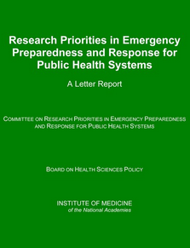
Many attempts, Few successes
ASTHO Bioterrorism Accountability Indicators Project
CDC Public Health Preparedness & Response Capacity
Inventory
﻿An Equal Opportunity University

Slide 4
A Brief History
2012
Collaborative Development: CDC, ASTHO and >25 collaborating organizations
1st Release: Initial model structure and results
  5 domains and 14 subdomains
  128 measures
2nd Release: Revised model and results
  6 domains and 18 active subdomains
  Measures: 119 retained + 75 new = 194 measures
Transition to Robert Wood Johnson Foundation
    Validation studies and revision to methodology & measures
3rd Release: Revised model and results
      6 domains & 19 active subdomains
      Measures: 65% retained, 12% respecified, 8 new = 135 total
      Valid comparisons over time + confidence intervals
4th Release: Refined model and results
      Added District of Columbia
      Measures: 4 dropped, 7 respecified, 8 new =139 total
12/2013
12/2014
1/2015
4/2016
4/2017
﻿An Equal Opportunity University

Slide 5
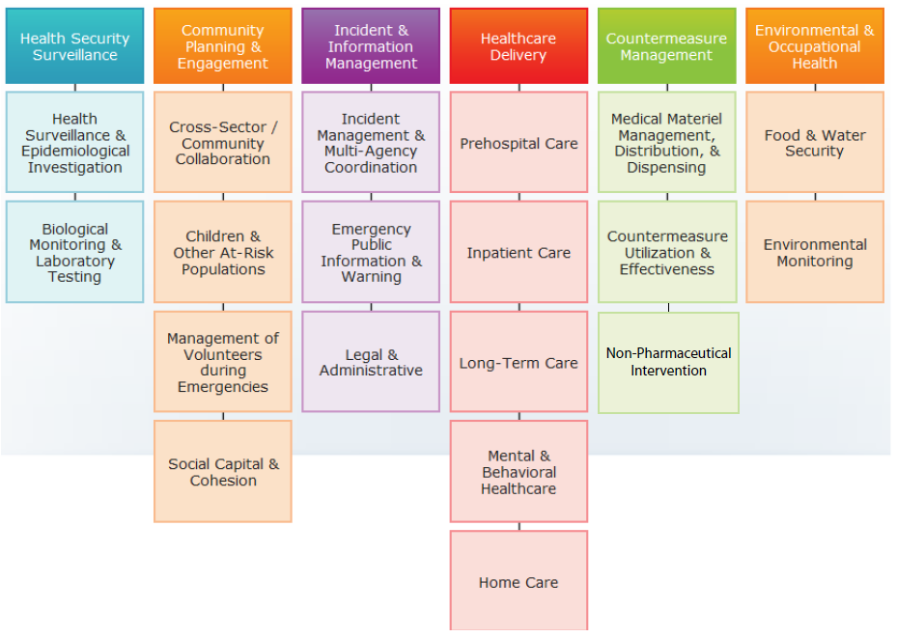

What the Index measures
﻿An Equal Opportunity University

Slide 6
Enhanced Methodology
139 individual measures
19 subdomains
6 domains
State overall values
National overall values
Normalized to 0-10 scale using min-max scaling to preserve distributions
Imputations based on multivariate longitudinal models
Empirical weights based on Delphi expert panels
Bootstrapped confidence intervals reflect sampling and measurement error
Annual estimates for 2013-2016
Weighted average
Weighted average
Weighted average
Reliability by Domain | Alpha
Health security surveillance | 0.712
Community planning & engagement | 0.631
Incident & information management | 0.734
Healthcare delivery | 0.596
Countermeasure management | 0.654
Environmental/occupational health | 0.749
Unweighted average
﻿An Equal Opportunity University

Slide 7
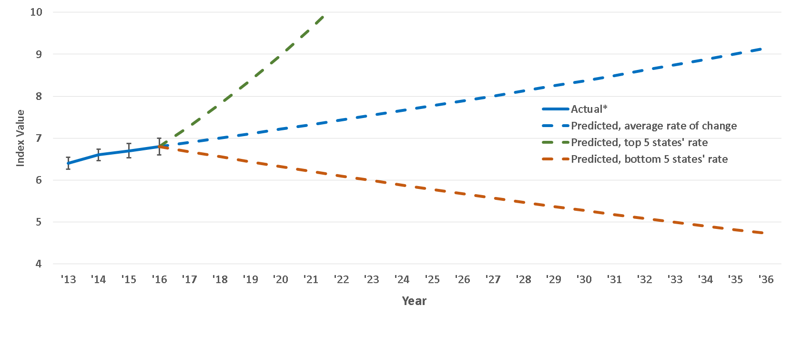

2017 Results
Steady but slow progress
﻿An Equal Opportunity University
*statistically significant change

Slide 8
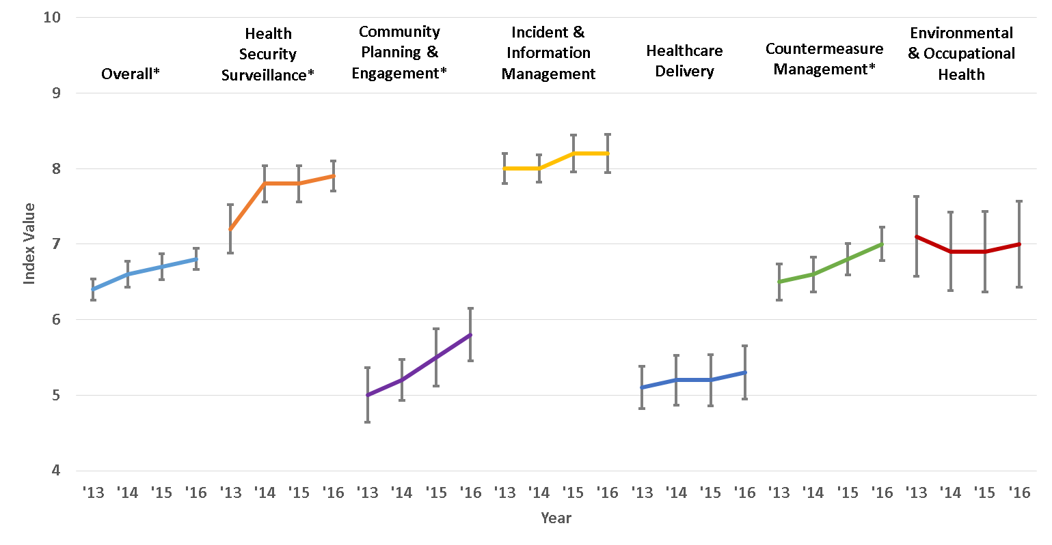

2017 Results
The U.S. improved in most domains during 2013-16,
except healthcare delivery and environmental health
﻿An Equal Opportunity University
*statistically significant change

Slide 9
2017 Results
Geographic disparities in health security are large and persistent
2013
2014
2016
2015
﻿An Equal Opportunity University
Above average Within average Below average %Increase in year %Decrease in year

Slide 10

2017 Results
Improvements occurred across the U.S.,
but 12 states trailed or lost ground
Below national average Within national average Above national average
﻿An Equal Opportunity University

Slide 11
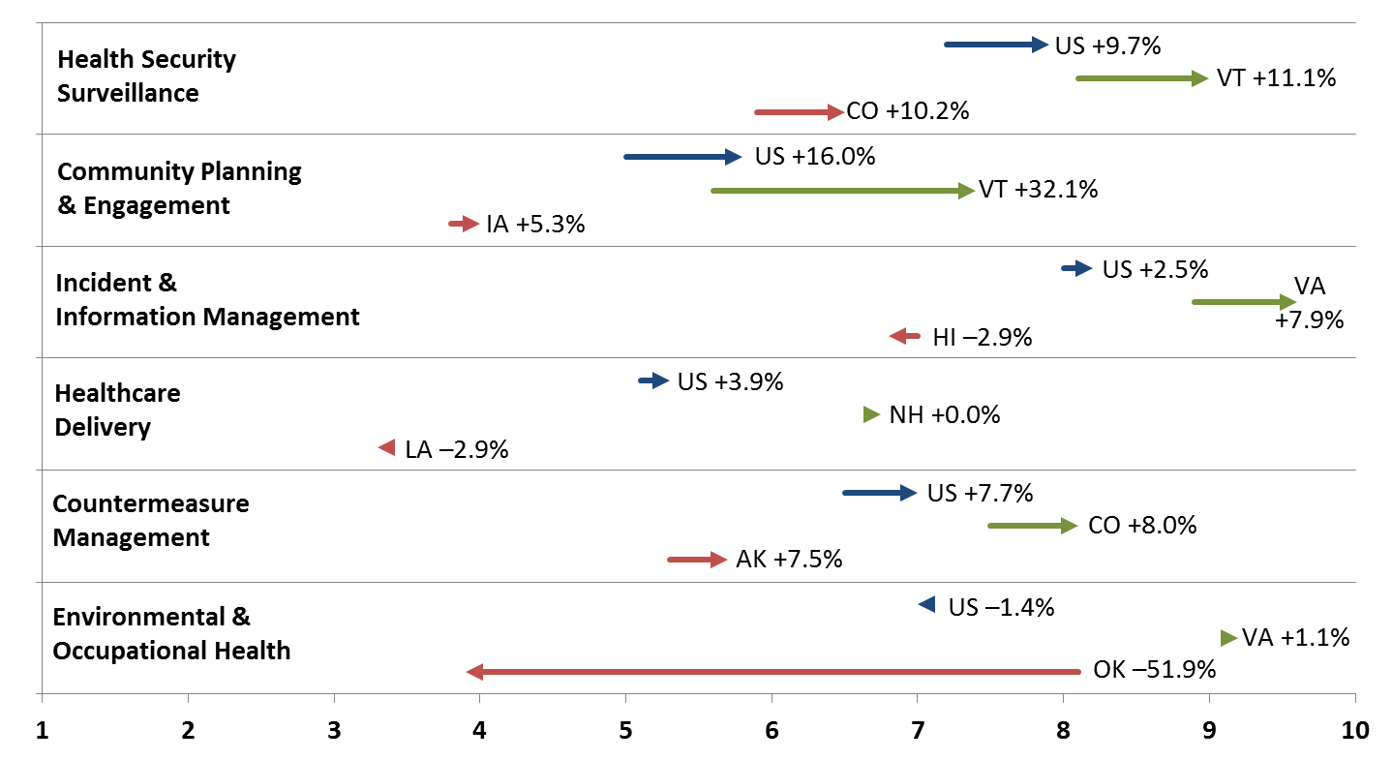

2017 Results
Changes vary widely across states and domains
Lowest State | US Average | Highest State
Index Values in 2013 and 2016
﻿An Equal Opportunity University

Slide 12
2017 Results
Health security tracks closely with social &
economic determinants of health
Percent of population below federal poverty threshold
Percent of population without health insurance coverage
﻿An Equal Opportunity University

Slide 13
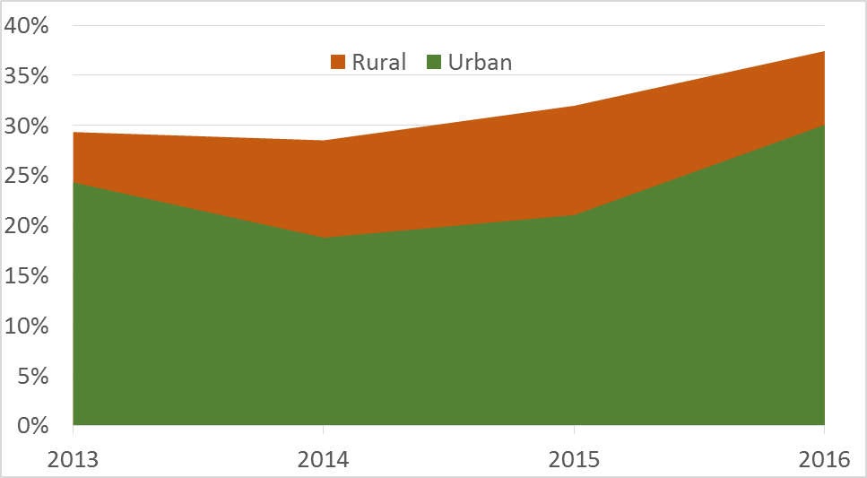
2017 Results
Rural-Urban differences in health security
Percent of population residing in a state
with below-average health security
Relative Risk: 23%*
﻿An Equal Opportunity University
*statistically significant difference

Slide 14
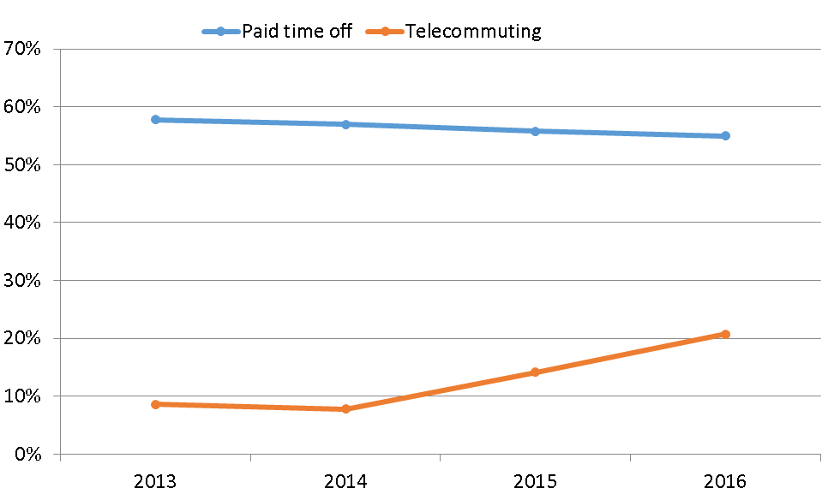
2017 Results
Underlying drivers: occupational
Percent of workers with paid sick leave and telecommuting opportunities
*
*
﻿An Equal Opportunity University
*statistically significant change

Slide 15
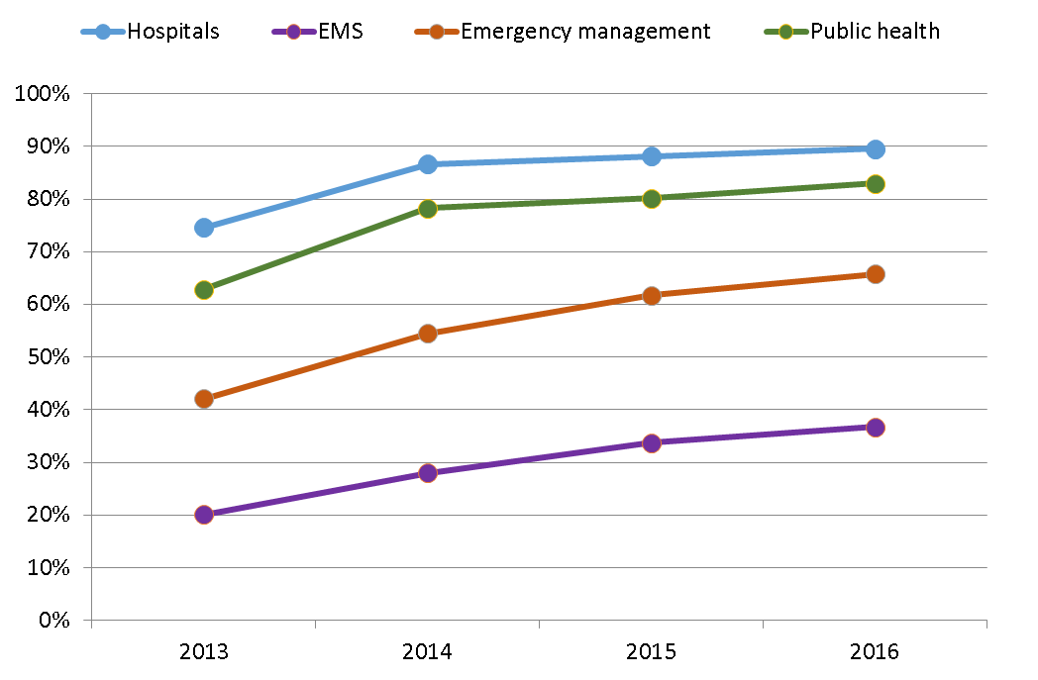
2017 Results
Underlying drivers: organizational
Participation in Healthcare Preparedness Coalitions
﻿An Equal Opportunity University

Slide 16
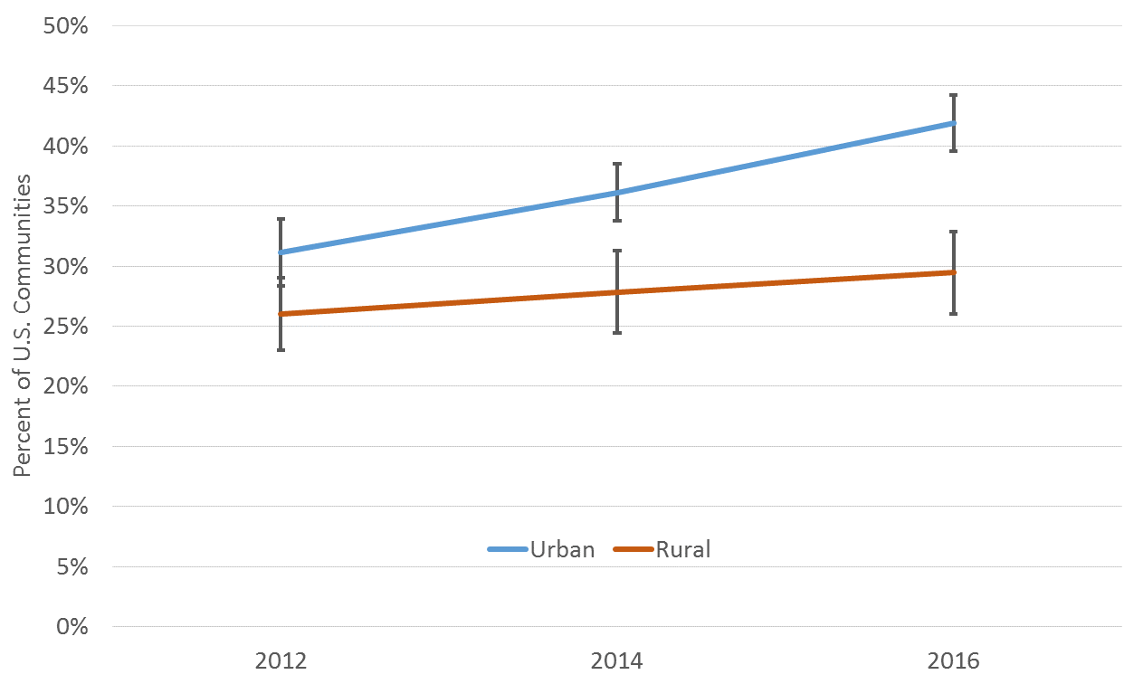
2017 Results
Underlying drivers: community and systems
Communities with Strong Multi-Sector Networks
(Comprehensive Public Health Systems)
﻿An Equal Opportunity University
*statistically significant difference

Slide 17

Next Challenge: Supporting Meaningful Use
If you build it, will they come?
Substantial progress in media coverage & use
Productive dialog with federal/policy stakeholders: CDC, ASPR, ASPE, GAO, OMB, NCSL
BUT…Limited engagement with state preparedness officials
﻿An Equal Opportunity University

Slide 18
Current Engagement Mechanisms
Call for new measures
Monthly workgroup meetings: methods, communications
Public comment period on suggested enhancements (Oct)
Delphi survey on measure importance (Nov-Dec)
Pre-release state preview period (March)
Quarterly webinars
Preparedness Innovator Challenge (March-June)
Data download, listserv, blogs, twitter
www.nhspi.org
To receive updates from the Health Security Index, email listserv@lsv.uky.edu with “Subscribe NHSPIndex” in the body
﻿An Equal Opportunity University

Slide 19
Caveats and cautions
Imperfect measures & latent constructs
Unmeasured capabilities
Timing and accuracy of underlying data sources
﻿An Equal Opportunity University

Slide 20
On the horizon
Exploratory work to include territories
and sub-state metropolitan areas
Tools and applications to support Index use
Analyses to uncover causes and consequences of change in health security
﻿An Equal Opportunity University

Slide 21
National Advisory Committee Members | 2016-17
Thomas Inglesby, MD (Chair), Johns Hopkins University
Robert Burhans, Health Emergency Management Consultant
Anita Chandra, DrPH, RAND
Mark DeCourcey, U.S. Chamber of Commerce Foundation
Eric Holdeman, Emergency Management Consultant
Harvey E. Johnson, Jr., American Red Cross
Ana Marie Jones, Interpro
Dara Lieberman, MPP, Trust for America’s Health
Nicole Lurie, MD, MSPH, ASPR (through 1/2017)
Suzet McKinney, DrPH, MPH, Illinois Medical District Commission
Stephen Redd, MD, CDC Office of Public Health Preparedness & Response
Richard Reed, MSW, American Red Cross (through 2/2016)
John Wiesman, DrPH, MPH, Washington State Secretary of Health
Special appreciation to Index collaborators at CDC, ASPR, ASTHO, APHL, NACCHO, RAND, members of the Model Design and Analytic Methodology Workgroup,
and the Stakeholder Engagement and Communications Workgroup.
Visit or join an Index workgroup at http://nhspi.org/get-involved/
﻿An Equal Opportunity University

Slide 22


For More Information
National Program Office
Supported by The Robert Wood Johnson Foundation
Glen P. Mays, Ph.D., M.P.H.
Email: NHSPI@uky.edu
Web: www.nhspi.org
www.systemsforaction.org
Archive: works.bepress.com/glen_mays
Blog: publichealtheconomics.org
To receive updates from the Health Security Index, email listserv@lsv.uky.edu with “Subscribe NHSPIndex” in the body
National Coordinating Center

