Slide 1


The Analytic Methodology Work Group Monthly Meeting for the
National Health Security Preparedness Index
May 13th, 2015
2:00pm – 3:00pm (EST)
Phone Line: 1-877-394-0659 / Access Code: 7129451782#
(Please mute computer speakers if using phone audio.)
NHSPI Program Management Office
University of Kentucky

Slide 2

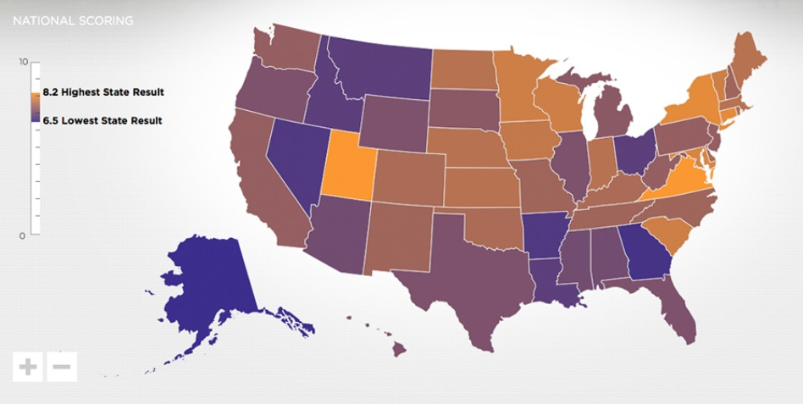

Agenda
NHSPI Project Update
  Model Design Workgroup April virtual meeting
  National Advisory Committee April virtual meeting
Weighting Approach
  Old = equal weighting of items within subdomains gives rise to large differences in implicit weighting in the overall Index
  New = explicit weights based on expert panel Delphi ratings
    reflect underlying science
﻿An Equal Opportunity University

Slide 3
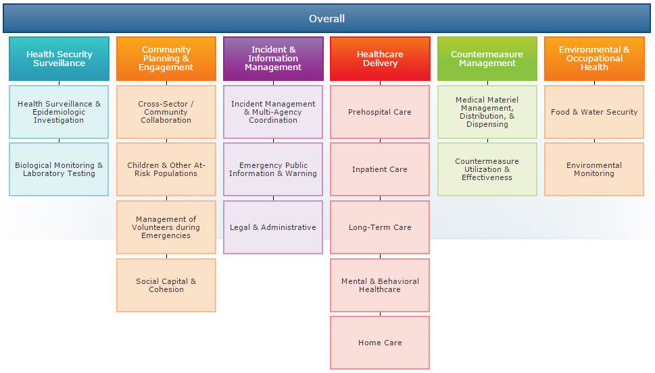
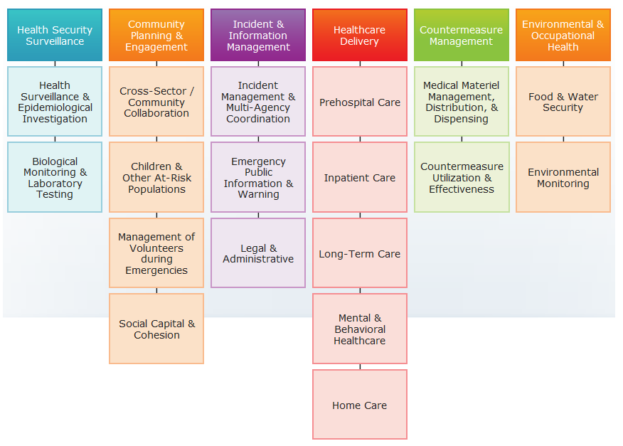
Current Index Structure and Framework:
Implicit Computational Weighting
﻿An Equal Opportunity University

Slide 4
Weighting
Expert panel, online Delphi approach
  What gets weighted?
    measures, subdomains, and/or domains?
  Weighted with respect to what?
    state-specific risks, all hazards, uniform planning scenarios?
  Who are the experts?

Slide 5
Upcoming Meetings
May 19, Model Design (virtual) 1-2 ET
June 9, NAC, Washington, D.C.
June 10, Analytic Methodology (virtual) 2-3 ET

Slide 6


For More Information
National Program Office
Supported by The Robert Wood Johnson Foundation
Glen P. Mays, Ph.D., M.P.H. glen.mays@uky.edu Anna Goodman Hoover, Ph.D. Anna.Hoover@uky.edu Michael Childress, M.A. Michael.childress@uky.edu
Email: NHSPI@uky.edu
Web: www.nhspi.org / www.publichealthsystems.org
Journal: www.FrontiersinPHSSR.org
Archive: works.bepress.com/glen_mays
Blog: publichealtheconomics.org
National Coordinating Center

