Slide 1


Model Design Work Group Meeting,
National Health Security Preparedness Index
February 2, 2015
May 19, 2015
NHSPI Program Management Office
University of Kentucky

Slide 2

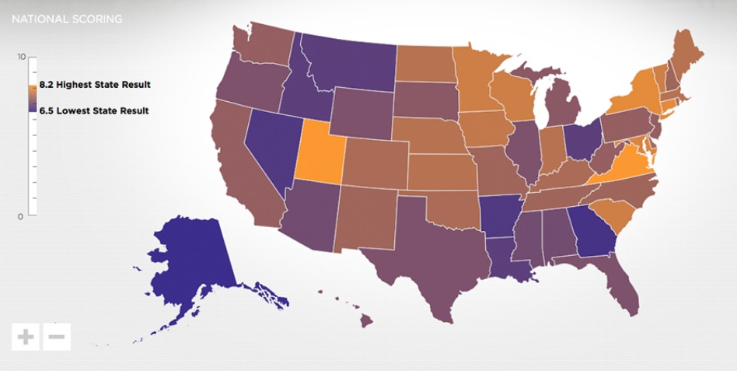

_{Agenda}
Project Update
  NAC, Analytic Methodology Workgroup
Index Structure & Framework
  Identifying the most pressing conceptual gaps
Measure selection
  Criteria
﻿An Equal Opportunity University

Slide 3
_{Overview of Activities:}
_{NAC Virtual Meeting, April 28}
Too much focus on disaster preparedness?
  Can we shift the focus toward creating healthy, resilient communities with high capacity?
Can we capture these concepts in the Index?
  Cooperation between government & non-governmental entities, planning capacity, system capacity
  Are there meaningful differences between capability/preparedness, response & recovery?
      Currently the focus is mostly on capability/preparedness
What limits, if any, do we place on measure selection?
  e.g., Meaningful v. Actionable v. Available
﻿An Equal Opportunity University

Slide 4
_{Overview of Activities:}
Analytic Methodology WG, 5/13/15
Analytic Methodology Workgroup
  Expert panel, online Delphi approach
    What gets weighted?
      measures, subdomains, and/or domains?
    Weighted with respect to what?
      state-specific risks (e.g., user defined?), all hazards, uniform planning scenarios
    Who are the experts?
﻿An Equal Opportunity University

Slide 5
_{Agenda}
Project Update
  NAC, Analytic Methodology Workgroup
Index Structure & Framework
  Identifying the most pressing conceptual gaps
Measure selection
  Criteria
﻿An Equal Opportunity University

Slide 6
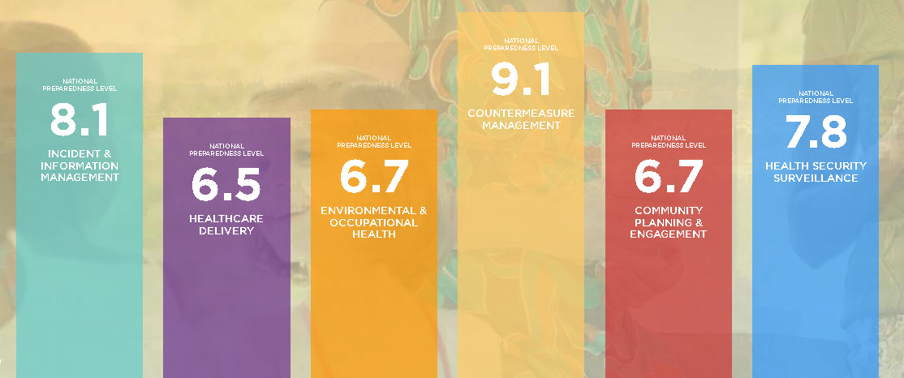
_{2014 Index Results}
National average: 7.5
State overall results range from 6.5 to 8.4
﻿An Equal Opportunity University

Slide 7
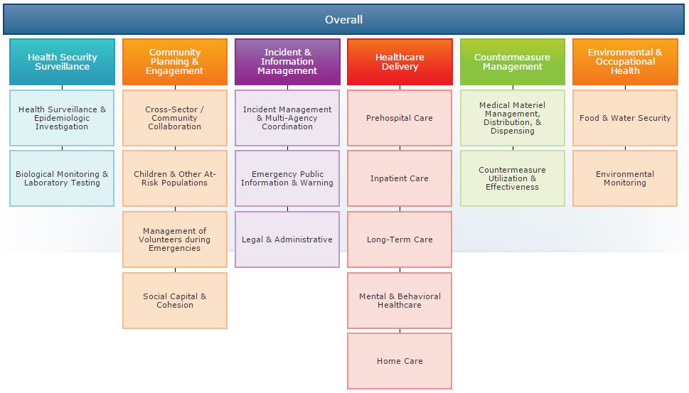
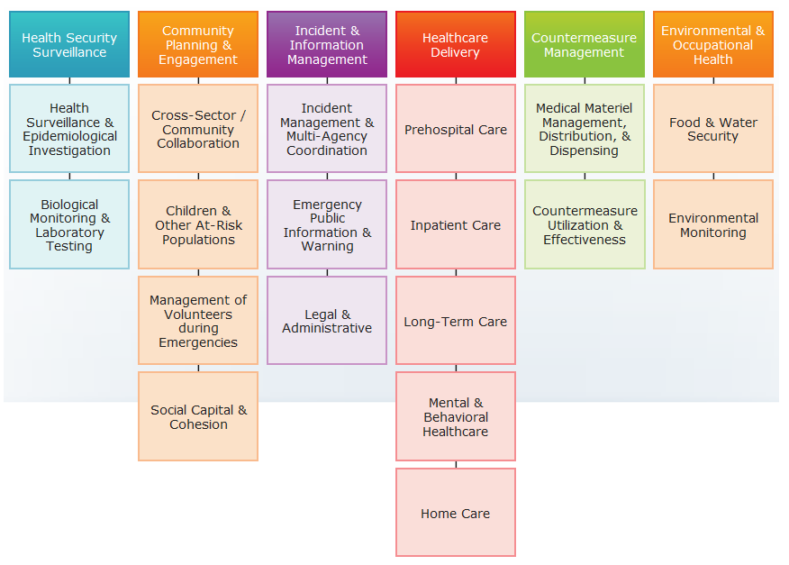
Current Index Structure and Framework:
Where are the most pressing conceptual gaps?
﻿An Equal Opportunity University

Slide 8
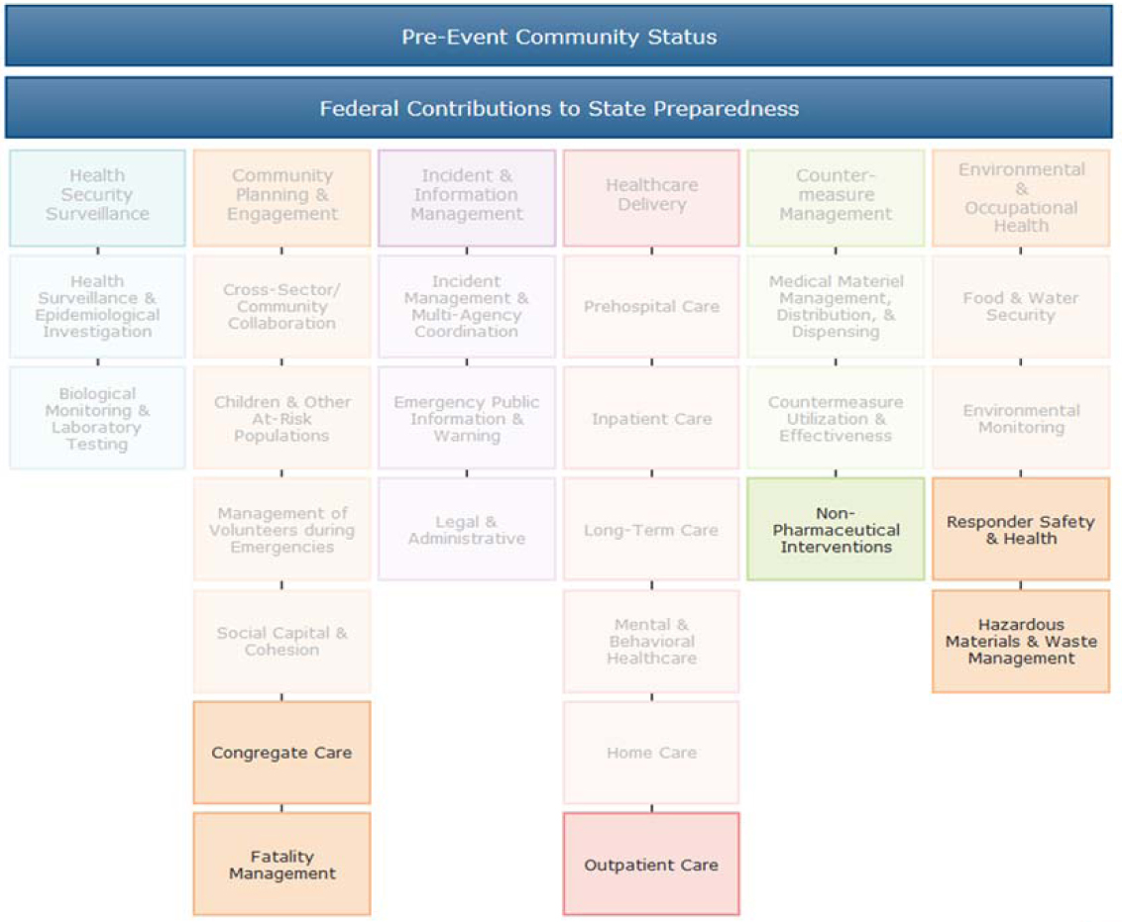
Prior Workgroup Recommendations
﻿An Equal Opportunity University

Slide 9
Additional Candidate Areas
Expand social, environmental economic indicators of preparedness & resilience
JCAHO compliance rates with emergency management standards: hospitals, nursing homes, home health, behavioral health
Infrastructure reliability: power, water, transportation, communication, housing, public facilities
Workplace policies: PTO, telecommuting
Cybersecurity measures
Inter-sectoral & inter-jurisdictional collaboration measures
Preparedness funding levels & distribution
﻿An Equal Opportunity University

Slide 10
_{Agenda}
Project Update
  NAC, Analytic Methodology Workgroup
Index Structure & Framework
  Identifying the most pressing conceptual gaps
Measure selection
  Criteria
﻿An Equal Opportunity University

Slide 11
_{Measure Selection}
What criteria should we consider when determining whether to include/exclude a measure?
  Validity, Reliability, Sensitivity, Specificity, Strength of Evidence, Parsimony, Availability, Actionable
Are these the right criteria?
  What’s missing?
What is most important?
﻿An Equal Opportunity University

Slide 12


For More Information
National Program Office
Supported by The Robert Wood Johnson Foundation
Glen P. Mays, Ph.D., M.P.H. glen.mays@uky.edu Anna Goodman Hoover, Ph.D. Anna.Hoover@uky.edu Michael Childress, M.A. Michael.childress@uky.edu
Email: NHSPI@uky.edu
Web: www.publichealthsystems.org
Journal: www.FrontiersinPHSSR.org
Archive: works.bepress.com/glen_mays
Blog: publichealtheconomics.org
National Coordinating Center

