Slide 1


Analytic Methodology Work Group Meeting, National Health Security Preparedness Index
February 2, 2015
April 8, 2015
NHSPI Program Management Office
University of Kentucky

Slide 2

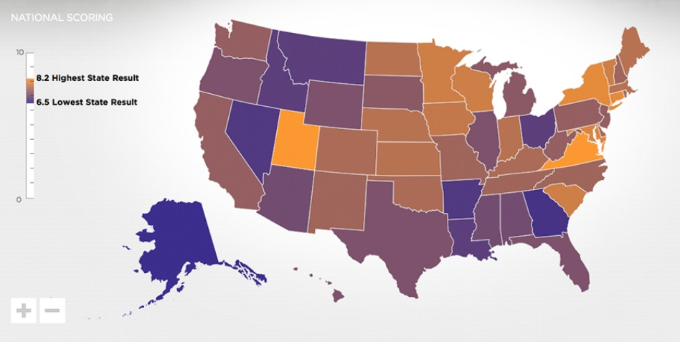

Agenda
Scaling Measures
  Old = actual/max ; trimming at +2 S.D
  New = (actual – min)/(max-min)
Weighting Approach
  Old = equal weighting of items within subdomains gives rise to large differences in implicit weighting in the overall Index
  New = weights based on expert panel Delphi ratings
﻿An Equal Opportunity University

Slide 3
Validation studies with 2014 Index
These differential outcomes are a function of model structure (implicit weighting) as well as the scaling approach.

Slide 4
Scaling and Weighting
Don’t want the measure scaling to have a differential impact on Index scores
  Dichotomous v. continuous
Do want the weighting to be explicit and reflect underlying science

Slide 5
Sensitivity Analyses

Slide 6
The Difference of a Scaling Change

Slide 7
Sensitivity Analyses

Slide 8
Scaling
Scaling Measures
  New scaling [(actual – min)/(max-min)] does not exercise a differential impact on Index scores
    Dichotomous & continuous measures scaled similarly

Slide 9
Weighting
Expert panel, online Delphi approach
  What gets weighted?
    measures, subdomains, and/or domains?
  Weighted with respect to what?
    state-specific risks, all hazards, uniform planning scenarios?
  Who are the experts?

Slide 10
Upcoming Meetings
April 21, Model Design (Virtual)

Slide 11


For More Information
National Program Office
Supported by The Robert Wood Johnson Foundation
Glen P. Mays, Ph.D., M.P.H. glen.mays@uky.edu Anna Goodman Hoover, Ph.D. Anna.Hoover@uky.edu Michael Childress, M.A. Michael.childress@uky.edu
Email: NHSPI@uky.edu
Web: www.nhspi.org / www.publichealthsystems.org
Journal: www.FrontiersinPHSSR.org
Archive: works.bepress.com/glen_mays
Blog: publichealtheconomics.org
National Coordinating Center

